Slide 1
Documenting Your Design
Sanket Singh SWE 2 @ Google

Slide 2
What will you learn
What is a design document ?
When to write a design document ?
One pager vs Design document
Important components of a design document
Sequence diagrams
Flow diagrams

Slide 3
What is a design doc?

Slide 4
What is a design document ?
Explain why & how something will be done. Design document serves as a high-level guide to understand what is being implemented and why.
Design document clarifies your design and make you think about the details before you start coding
Increase the visibility of the work across the team.
Receive early feedback and avoid wanted work and identify early design issues.
Serve as an historical record.
Get and record agreement from interested parties.

Slide 5
When to write a Design document?

Slide 6
When to write a design document ?
If a feature is tricky
If a feature is risky
If a feature is lengthy
If a feature required integration with other teams and collaboration with them
If there are conflicting opinions about the approach

Slide 7
One Pager vs Design Document

Slide 8
One Pager
Purpose: A one-pager is a concise document, often literally one page, used to propose a new feature, idea, or provide a high-level overview of a project. Its main goal is to communicate the core concept quickly and efficiently.
Content: It usually includes a brief description of the idea, its purpose, potential benefits, and possibly high-level considerations for implementation. It might also cover key objectives, target audience, and basic requirements.
Audience: This document is generally meant for stakeholders and team members to quickly grasp a concept or proposal. It's useful for initial discussions or to get buy-in for a project.
Detail Level: Low to moderate. It provides enough information to understand the idea but doesn't delve into technical specifics.
Use Cases: Often used in the early stages of project planning or when proposing new features or changes.

Slide 9
Design document
Purpose: A design document is a detailed, comprehensive description of the design of a software system or feature. It's used to guide the development process and ensure all team members have a common understanding of the project.
Content: This document includes in-depth information about the software's architecture, components, data design, user interface, security considerations, and more. Key elements might include: Detailed architectural diagrams, Descriptions of system components and their interactions, User interface layouts and flow diagrams, Data models and database schema, Security protocols, Performance and scalability considerations
Audience: Design documents are intended for the development team, including architects, developers, testers, and project managers.
Use: They are essential during the development phase, providing detailed guidance on how to build the system.

Slide 10
Components Of a Design Document

Slide 11
Objective
Summarize the change that any solution would need to make in order to appropriately address the problem being solved in 1-2 sentences.
Keep it short and assume familiarity
Unfamiliar users will get the context from background section

Slide 12
Requirements
List all specific requirements that any successful solution would need to meet.
All the requirements together should match the summary above.
These will be used as a criteria to judge if a proposed solution is complete.
These should contain function and non-functional requirements both.

Slide 13
Out of scope
List things that are deliberately placed out of scope for the document may be because it will be addressed in another document or the information is obsolete or it is not relevant now.

Slide 14
Background
All the details one need to know to understand the document.
Link to pull requests, bugs, examples, previous documents.

Slide 15
Flag changes
Any requirements for guarding changes behind a flag, for A/B testing or phased roll out should be called out here.

Slide 16
Mocks
If your feature includes any UI changes, or showing the UI makes it easy to understand the backend interaction then it should be mentioned.

Slide 17
Detailed Design
Here is your chance to explain how will you achieve each and every requirement
All the logical details goes here.
This is the most important part of your doc and should not have any mistakes in terms of technicalities.
Mention the caveats and comparisons
Mention if you can reuse some code, or what new code you will write
This section contains both HLD and LLD of the feature

Slide 18
Alternatives considered
Explain why other solutions are not preferable
You can consider mentioning cost implications, complexity, feasibility, efficiency of different approaches
Mention why the preferred approach is the best of all according to you
Write pros and cons of each
Mention the tradeoffs if any
Mention limitations of each approach

Slide 19
Performance & System health
Performance can mean visual speed, uptime, freshness of information, responsiveness, cost to run
Call out key performance goals in your design
Mention the dependent systems that might affect performance of your system
Consider key system health metrics like:
Memory, APP size, Disk usage, network usage, etc

Slide 20
APIs and RPCs
Whatever are the concerned APIs that you will either write or consume, mention them
Write the signature of the API and how will you use these API/RPC
Write expected server latencies and will the UI wait for the data to be fetched (may be you want to show loading state) or the data might be prefetched
Write caching requirements and how staleness can affect the feature
If you are changing an existing API/RPC mention if there will be increase in payload size or will there be some latency ?
Will the API/RPC be called periodically , if yes then then with what frequency

Slide 21
Database changes
Call out any DB level changes like, new table / collection being introduced, new indexes being introduced
If you are going to do some DB queries, then write why your query is an efficient one and can there be some alternative ex: may be you propose joining multiple tables on the fly, but another approach can be to prepare views prior and then query the view

Slide 22
Launch plan
How are we planning to ramp up the feature
Will this launch be periodic or released in one go
Do we have flag guarding the changes
Are we doing A/B experiments
If yes then details of every arm and changes expected in the arms
Mention rollback strategy

Slide 23
Metrics & Monitoring
Usage metrics: It means metrics around visual element interaction by user, how much time they spend on a page, what’s the drop in funnel looking like.
Success metrics: What change is going to be considered as success
Regression metrics: What change will be considered as a regression for your feature ?

Slide 24
Security and Privacy

Slide 25
Server driven configurations

Slide 26
Testing Plan
Do we expect some manual testing to be done ?
Do we expect some integration tests and unit tests to be written ?

Slide 27
Work Estimates
Break the whole feature into multiple small efforts and write an expected timeline
Write for each work if it is small medium or large
Write the order in which you target to implement the tasks

Slide 28
Future Work
What are the work items that are nice to have but not part of this release
Any technical debt you are incurring or not

Slide 29
Sequence Diagram
A sequence diagram in software engineering is a type of diagram that illustrates how objects in a system interact in a specific sequence of events. It's part of the Unified Modeling Language (UML) and is used to depict the flow of messages between different entities (like objects or actors) over time. Key features include:
- Objects and Actors: Represent the entities interacting in the system.
- Lifelines: Vertical lines showing the presence of an object over time.
- Activation Bars: Rectangles on lifelines indicating when an object is active.
- Messages: Arrows representing communication between objects.
- Return Messages: Optional dotted arrows showing responses.
These diagrams are useful for visualizing system interactions, making complex processes easier to understand and analyze.

Slide 30
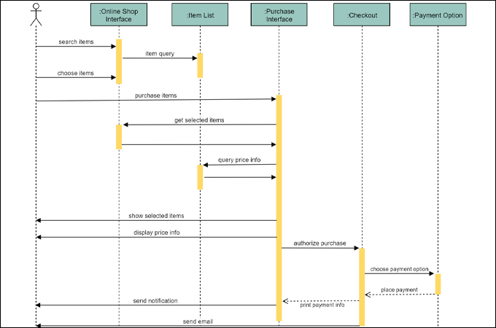

Slide 31
Flow Diagram
A flow diagram is a graphical representation used to illustrate the sequence of steps in a process or system. It uses standardized shapes like rectangles, diamonds, and arrows to depict different actions, decision points, and the flow of control. Start and end points are typically shown with rounded shapes, and inputs and outputs are marked with parallelograms. Flow diagrams are useful for simplifying complex processes and identifying areas for improvement.

Slide 32
